Slide 1


EARLY WARNING SYSTEM
Innovation Sprint | Year I & Semester II
Student Name: ___________________ & Roll No: ___________________ Team
Student Name: ___________________ & Roll No: ___________________ Name: _______________________________
Student Name: ___________________ & Roll No: ___________________
Student Name: ___________________ & Roll No: ___________________ Mentor
Student Name: ___________________ & Roll No: ___________________ Name: _______________________________
Student Name: ___________________ & Roll No: ___________________

Slide 2
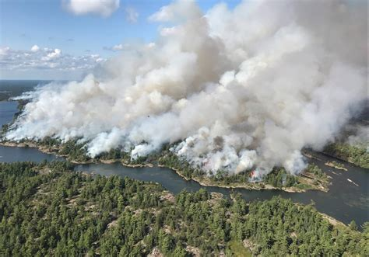
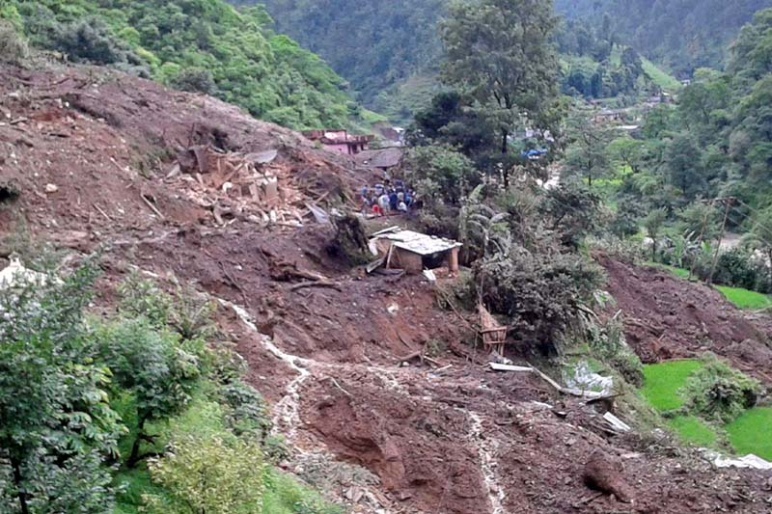
Challenge
Problem: Vulnerable communities often lack access to timely and effective early warning systems (EWS), leaving them exposed to the devastating impacts of natural disasters and other hazards. This can lead to significant loss of life, injuries, displacement, and damage to infrastructure and livelihoods.
A Community-Based, Multimodal, and Culturally Aware Early Warning System (CB-MCEWS)

Slide 3
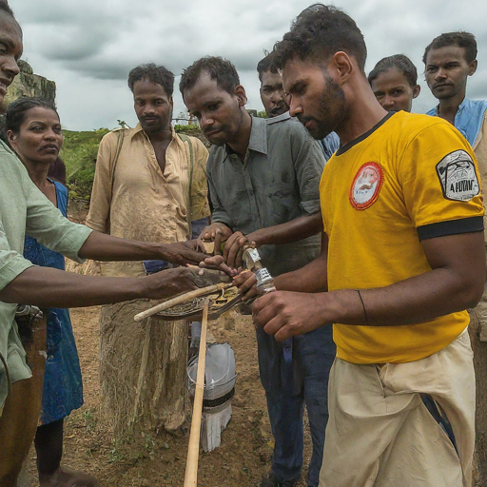
Significance
Team 53
Vulnerable communities lack early warnings, costing lives in disasters.
Impact: Huge - loss of life, displacement, ruined livelihoods. Affects poorest most.
Widespread: Global problem - floods, earthquakes, climate change, more.
Importance: Saves lives, protects economies, builds resilience.
Why I care: Moral duty, global challenge, scalable solutions, aligns with values.
Image: Diverse villagers setting up a simple early warning system.
Goal: Safer, more resilient world for all.

Slide 4
Target User
The target users for an early warning system in vulnerable communities include residents, local leaders, relief organizations, emergency responders, infrastructure operators, and healthcare providers. Indigenous communities living in flood-prone, remote areas with limited access to technology and infrastructure.
Use case
For vulnerable communities, an early warning system could be crucial for natural disasters like floods, hurricanes, or earthquakes. The specific use case could involve timely alerts via mobile phones or community loudspeakers, providing instructions on evacuation routes, safe shelters, and essential emergency supplies. This system would aim to minimize loss of life and property by ensuring that community members are informed and prepared to take necessary actions before disaster strikes.

Slide 5
Existing Solutions
Satellite-based early warning systems:
Use satellites to monitor environmental changes and predict hazards like floods, wildfires, and landslides.
Examples:
The National Oceanic and Atmospheric Administration (NOAA) uses satellites to monitor weather patterns and issue warnings for potential hurricanes, floods, and other severe weather events.
The European Space Agency (ESA) has developed a Sentinel Asia program that provides satellite-based data for disaster risk reduction in Asia.

Slide 6
Adoption Barriers
• Lack of awareness: Communities might not understand the benefits of EWS or how to use it effectively.
• Perceived complexity: Systems perceived as difficult to use or understand might discourage adoption.
• False alarms: Frequent false alarms can erode trust and lead to ignoring future warnings.
• Limited ownership: If communities don't participate in design and implementation, they might feel less invested in using the system.
• Competition with existing systems: Traditional warning systems or community networks might need to be integrated or considered in adoption strategies.
• Addressing these constraints and barriers requires collaborative efforts involving communities, technology developers, and relevant authorities.

Slide 7
Value Proposition
Statement :
Protect lives and livelihoods in vulnerable communities with EWS, an early warning system tailored to your unique needs. Get actionable alerts before disaster strikes, minimize losses, and build long-term resilience.
Challenges Overcome:
Tailored alerts: Addresses the inadequacy of generic warning systems by providing alerts customized to each community's unique needs.
Timely response: Overcomes the delay in response caused by traditional warning methods through proactive alerts.
Long-term resilience: Empowers communities to build adaptability over time, surpassing short-sighted solutions that only address immediate needs.

Slide 8
Solution Concept
Data Analysis: Analyzing sensor data, weather forecasts, and historical records to predict impending threats like floods, landslides, or heatwaves.
Risk Assessment: Identifying areas and individuals most vulnerable based on location, infrastructure, and social factors.
Personalized Alerts: Delivering targeted warnings through multiple channels (SMS, mobile apps, sirens) considering accessibility and language needs.
Dynamic Response: Continuously learning and adapting alert thresholds and communication strategies based on community feedback and real-time data.
Resource Optimization: Coordinating emergency response efforts and resource allocation based on predicted impacts and community needs.
Community Engagement: Facilitating two-way communication with community leaders and residents to increase trust and awareness.
Evaluation & Improvement: Monitoring the system's effectiveness, measuring response times, and gathering feedback to improve future performance.

Slide 9
Benefits
The benefits of solving the problems addressed by our Early Warning System (EWS) include:
1. Reduced Losses: By providing actionable alerts before disasters strike, EWS helps minimize casualties, property damage, and economic losses, thereby safeguarding lives and livelihoods.
2. Improved Preparedness: Communities equipped with EWS are better prepared to respond to disasters, resulting in more efficient and effective emergency response efforts, potentially saving more lives and reducing the impact of disasters on infrastructure and resources.
3. Enhanced Resilience: By fostering long-term resilience through proactive risk management and community engagement, EWS empowers communities to bounce back more quickly from disasters and to adapt to changing environmental conditions, ultimately promoting sustainable development and prosperity.

